Slide 1
Managing Packages and Software
Identify Package Managers
Manage RPM Packages with YUM
Manage Debian Packages with APT
Configure Repositories
Acquire Software
Build Software from Source Code
Troubleshoot Software Dependency Issues

Slide 2

Topic A: Identify Package Managers
Exam Objectives:
2.1 Given a scenario, conduct software installations, configurations, updates, and removals.

Slide 3
Package Managers
Programs that install, update, inventory, and uninstall packaged software.
Alternative is to compile software from source code.
Common in Linux due to open nature.
Package managers govern software lifecycle.
Control what is installed.
Manage versions.
Enable easy uninstalling.
Package is a collection of files needed by program to run.
Pre-compiled app.
Supporting files.
Supporting documentation.

Slide 4
Software Dependencies
Many Linux apps are modular and depend on other software.
Packages list dependencies.
Required components.
Software will not run without them.
Package managers check for dependencies before installing.
"Failed dependency" errors may arise.
Notes:
Teaching Tip: Software dependencies will be discussed in more depth in a later topic.

Slide 5
Red Hat Installation vs. Debian Installation vs. Compiling (Slide 1 of 2)
Two dominant package managers:
Red Hat Package Manager (RPM)
Debian Package (dpkg)
Different design, but similar functionality.
Choice depends on distro.
Compiling is a traditional alternative.
Enables users to make changes to code before installing.
Can customize software to your liking.
Takes more effort and knowledge.

Slide 6
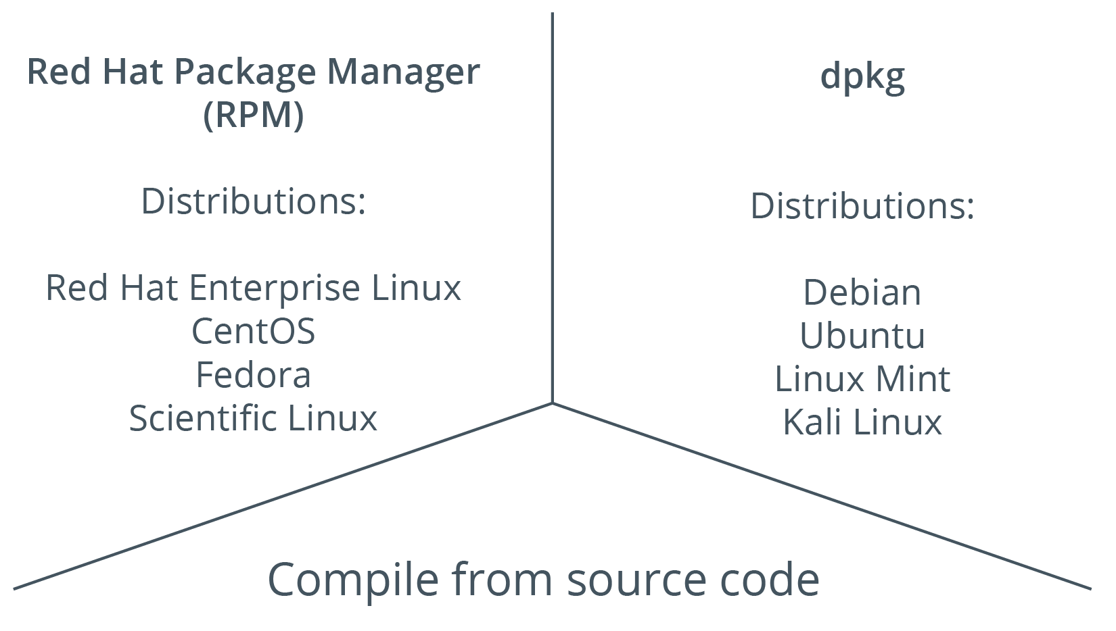
Red Hat Installation vs. Debian Installation vs. Compiling (Slide 2 of 2)

Slide 7
Red Hat Package Managers
Packages prepared by RPM use .rpm extension.
RPM is flexible and powerful.
Can inventory software easily.
YUM is newer.
Relies on .rpm packages.
More elegant and flexible commands.
Greater dependency handling.
Preferred in most cases.

Slide 8
Debian Package Managers
Packages prepared by dpkg use .deb extension.
dpkg can control entire software lifecycle.
APT is newer.
Relies on .deb packages.
More flexible.
Preferred in most cases.

Slide 9
DNF and Zypper
DNF:
Improved version of YUM.
Uses fewer resources.
Supports RPM.
Simplified commands.
Most YUM subcommands still usable.
Zypper:
Supports dependency solving.
Supports lifecycle management.
Used in openSUSE.
Supports .rpm packages.
Excellent at package management.

Slide 10
Discussing Package Managers

Slide 11
Activity 11-1: Discussing Package Managers
Your company has standardized on CentOS as the corporate Linux distribution. You want the greatest amount of control over how programs are installed, where they are installed, and all install options. Which install method works best for your requirements?
ANSWER:
Installing from source gives administrators the greatest amount of control over options at compile time.

Slide 12
Activity 11-1: Discussing Package Managers
You need to install the Apache web service on your new CentOS web server farm and you cannot decide between using a package manager and compiling. You look at both options thoroughly and decide that, for your current needs, installing via package manager will be adequate. Which package manager do you use to install Apache?
ANSWER:
CentOS is a Red Hat Enterprise Linux derivative and YUM is the preferred package manager to use.

Slide 13
Activity 11-1: Discussing Package Managers
Your development team at Develetech needs to modify some MySQL database software to optimize it for a database application. You have installed MySQL using YUM. What do you need to do to accommodate the modification need?
ANSWER:
Uninstall MySQL using YUM. Have the developers acquire the MySQL source code, modify it, and then you can compile and install the software manually.

Slide 14
Activity 11-1: Discussing Package Managers
What is the purpose behind using a package manager to install software?
ANSWER:
Package managers make it much easier to install software, control what software is installed, manage software versions, and uninstall the software.

Slide 15
Activity 11-1: Discussing Package Managers
You have used Red Hat Enterprise Linux and some of its derivative distributions, but you want to try a Debian-based distribution because of the APT package manager. Aside from Debian itself, what are some common Debian-based distributions you can choose from?
ANSWER:
Ubuntu, Linux Mint, Kali Linux, SteamOS, and openSUSE are all common Debian-based distributions available to you that use APT for software installation.

Slide 16
Activity: Identifying Package Managers
Develetech will use CentOS and Ubuntu servers.
You need to configure package management solutions for both.
You'll decide which are most appropriate.

Slide 17
Topic B: Manage RPM Packages with YUM
Exam Objectives:
2.1 Given a scenario, conduct software installations, configurations, updates, and removals.

Slide 18
The rpm Command (Slide 1 of 2)
Manages RPM packages.
Option | Used To
-i {package name} | Install the specified software.
-e {package name} | Uninstall the package.
-v | Enable verbose mode.
-h | Print hash marks as a progress bar.
-V {package name} | Verify software components of package exist.

Slide 19
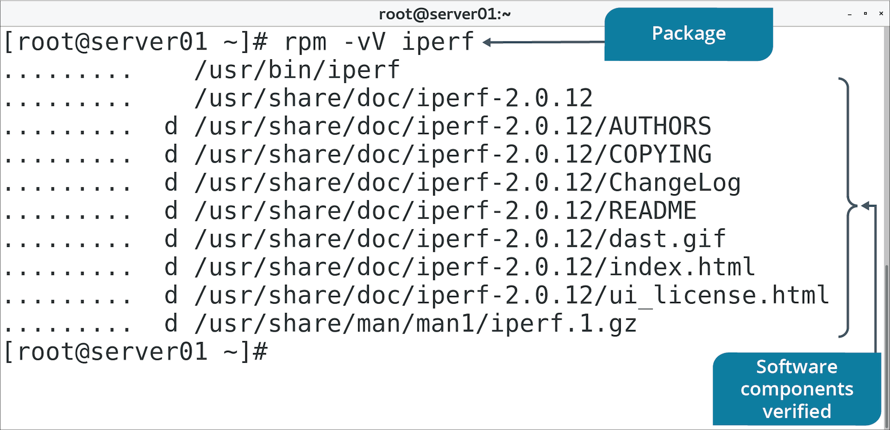
The rpm Command (Slide 2 of 2)

Slide 20
RPM Querying (Slide 1 of 2)
Use to maintain a database of software info.
Command | Used To
rpm -qa | List all installed software.
rpm -qi {package name} | List information about a package.
rpm -qc {package name} | List configuration files for a package.

Slide 21
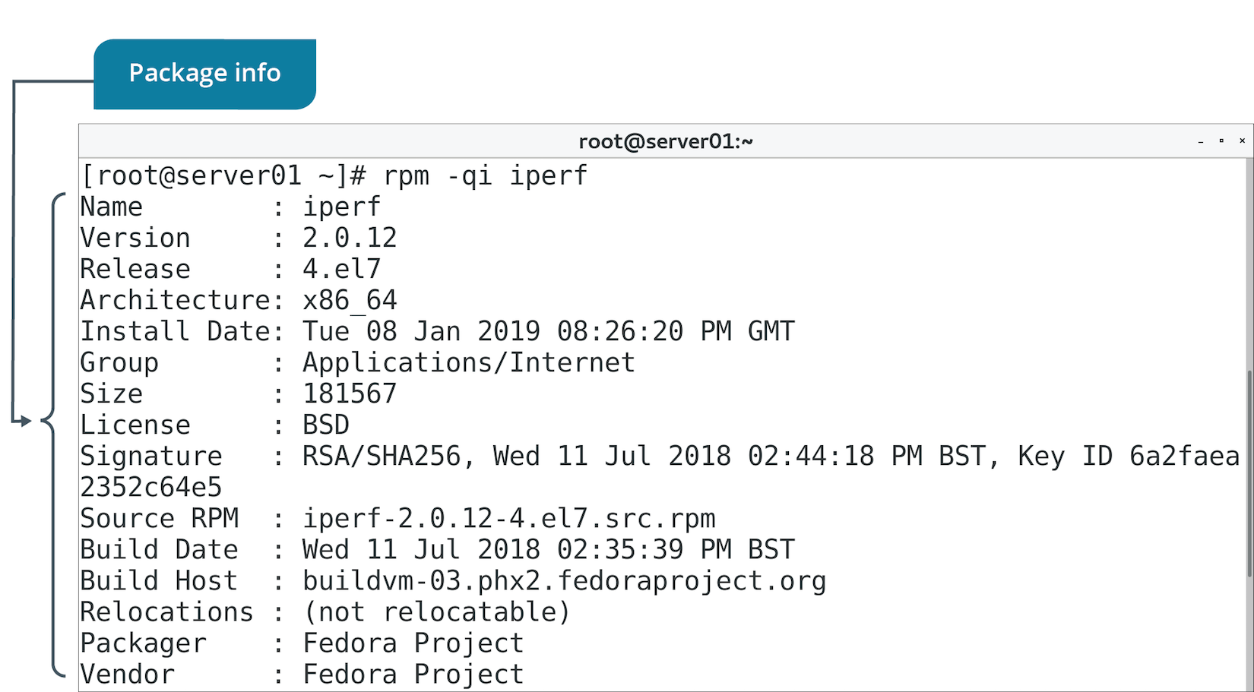
RPM Querying (Slide 2 of 2)

Slide 22
RPM Verification
Checks if installed components match what should be installed.
Used in troubleshooting to ensure package is installed and valid.

Slide 23
RPM Upgrades
-U option upgrades installed package.
Installs package if it isn't already.
-F option freshens installed package.
Upgrades but doesn't install package if it isn't already.

Slide 24
The yum Command (Slide 1 of 2)
Improves on rpm command.
Provides more straightforward management.
Can handle software dependencies.
Installs package and any packages it needs.
Can uses repositories.
Store .rpm files.
Enable admins to maintain version control.
Notes:
Teaching Tip: Students will learn more about configuring repositories in a later topic.

Slide 25
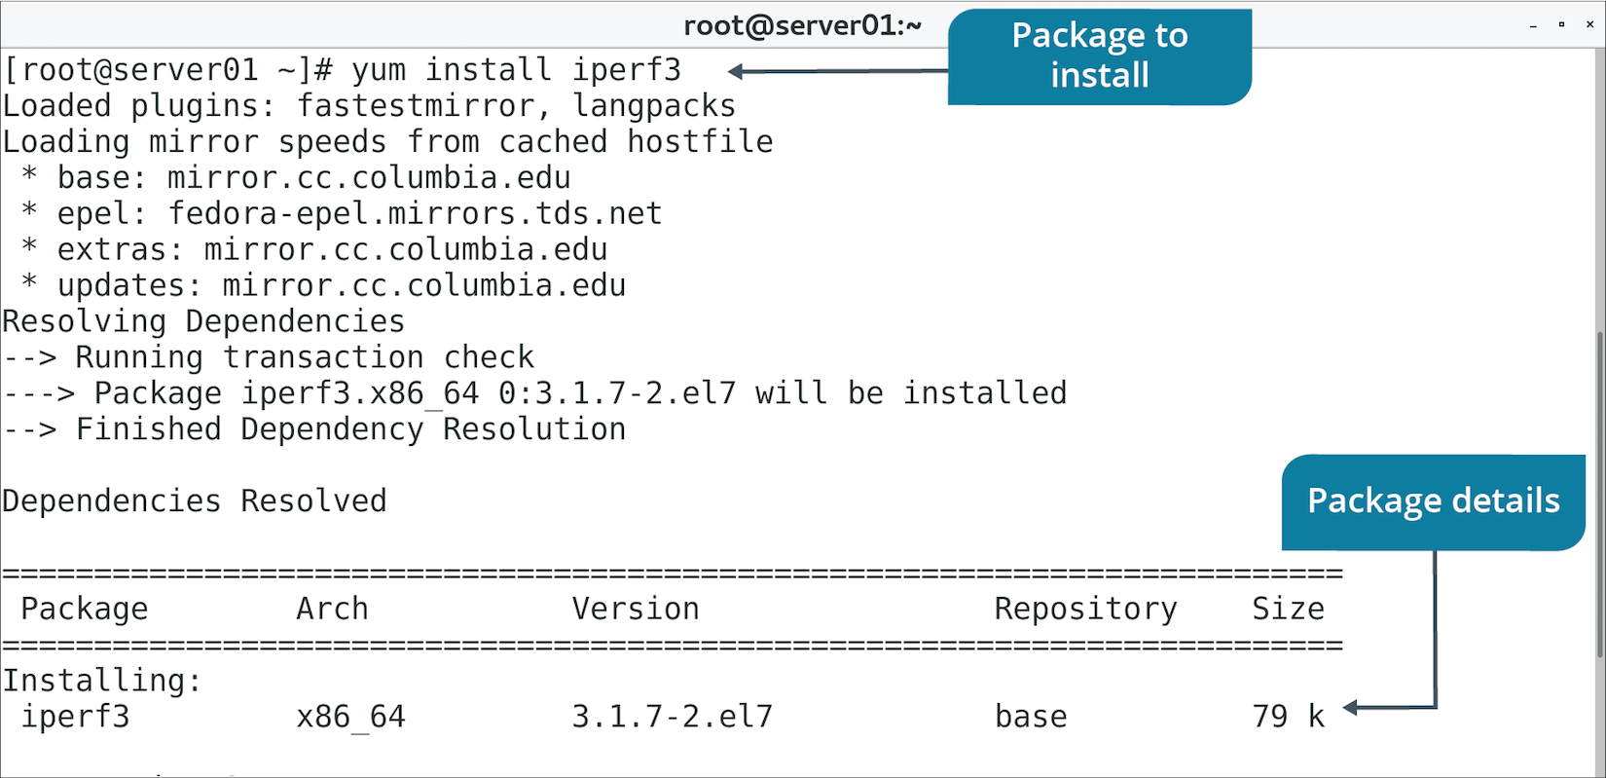
The yum Command (Slide 2 of 2)

Slide 26
yum Subcommands
Subcommand | Used To
install {package name} | Install package from any configured repository.
localinstall {package name} | Install package from local repository.
remove {package name} | Uninstall package.
update [package name] | Update package or all installed packages if no argument given.
info {package name} | Report info about package.
provides {file name} | Report what package provides specified files.

Slide 27
Discussing Managing Software with RPM and YUM

Slide 28
Activity 11-3: Discussing Managing Software with RPM and YUM
You are teaching a junior administrator how to install software via YUM. You ask him to install the Lynx text-based web browser (lynx) on a test system. What should the install command look like?
ANSWER:
sudo yum install lynx

Slide 29
Activity 11-3: Discussing Managing Software with RPM and YUM
You need to remove the Apache web service software package (httpd) so that you can install via source code. Using YUM, what command can you issue to uninstall Apache?
ANSWER:
sudo yum remove httpd

Slide 30
Activity 11-3: Discussing Managing Software with RPM and YUM
You want to install the xterm package onto your Linux workstation and don't want to wait for xterm and all its dependencies to be found before you acknowledge the installation. Using YUM, how can you install xterm and its dependencies without having to interact with the installation?
ANSWER:
sudo yum -y install xterm

Slide 31
Activity 11-3: Discussing Managing Software with RPM and YUM
You need to install several packages that the developers have downloaded and placed into a shared directory (/scratch). These are all RPM packages. How can you install the rdesktop-0.9.rpm package, for example?
ANSWER:
sudo yum localinstall /scratch/rdesktop-0.9.rpm

Slide 32
Activity 11-3: Discussing Managing Software with RPM and YUM
You have taken a position as a system administrator at a new company and have done some discovery work on the environment. You've noticed that multiple software packages are more than one year out of date on several CentOS systems. Using YUM, which command can you issue to update all software packages on each system without acknowledging or confirming the update?
ANSWER:
sudo yum -y update

Slide 33
Activity: Managing Software with RPM and YUM
You've been asked to demo software management on CentOS.
You'll install KornShell RPM.
You'll install Very Secure FTP with YUM.
Notes:
Teaching Tip: These steps are meant to get students acquainted with the package management lifecycle.

Slide 34
Topic C: Manage Debian Packages with APT
Exam Objectives:
2.1 Given a scenario, conduct software installations, configurations, updates, and removals.

Slide 35
The dpkg Command
Manages Debian packages.
Option | Used To
-i {package name} | Install the package.
-r {package name} | Uninstall the package.
-l [package name] | List info about package or all packages if no argument given.
-s {package name} | Report whether package is installed.

Slide 36
The apt Command
APT is front-end to dpkg, like YUM to RPM.
Most common way to manage .deb packages.
Common tools in the format apt-*
apt-get, apt-cache, etc.
Older style.
Newer command is simply apt
More streamlined.

Slide 37
apt Subcommands
Subcommand | Used To
install {package name} | Install package.
remove {package name} | Uninstall package, leaving behind config files.
purge {package name} | Uninstall package, removing config files.
show {package name} | Report info about package.
version {package name} | Display version info about package.
update | Update the APT database of available packages.
upgrade [package name] | Upgrade package or all packages if none provided.

Slide 38
Debian Package Upgrades
apt update updates APT database.
APT becomes aware of new versions from repositories.
Doesn't install any software.
apt upgrade upgrades all installed software.
Based on newer versions of packages in APT database.
Can be time-consuming.
You can specify individual packages to upgrade rather than all.
Run apt update first, then apt upgrade after.

Slide 39
Discussing Managing Software with dpkg and APT

Slide 40
Activity 11-5: Discussing Managing Software with dpkg and APT
You are teaching a CentOS Linux administrator how to install software on a Debian-based Linux system via APT. Which command can you use to install the text-based browser Lynx (lynx)?
ANSWER:
sudo apt install lynx

Slide 41
Activity 11-5: Discussing Managing Software with dpkg and APT
You need to remove the MySQL software package (mysql) so that you can install the program via source code, but you want to keep all configuration files intact. Using APT, what command can you issue to uninstall MySQL while leaving the configuration files?
ANSWER:
sudo apt remove mysql

Slide 42
Activity 11-5: Discussing Managing Software with dpkg and APT
It has been a few months since the old system administrators, who are now no longer with the company, updated the Linux systems. The first thing you need to do is to update the APT database with a fresh list of available packages. How do you update the APT database?
ANSWER:
sudo apt update

Slide 43
Activity 11-5: Discussing Managing Software with dpkg and APT
You need to totally remove the emacs package and its configuration files as well. Using APT, what command can you use to do this?
ANSWER:
sudo apt purge emacs

Slide 44
Activity 11-5: Discussing Managing Software with dpkg and APT
You have taken a position as system administrator at a new company and have done some discovery work on the environment. You've noticed that multiple software packages are more than one year out of date on several Debian systems. Which command can you issue to update all software packages on each system?
ANSWER:
sudo apt upgrade

Slide 45
Activity: Managing Software with dpkg and APT
Some Develetech systems are Debian-based.
They need to undergo network troubleshooting.
You'll download and install the nmap package.
You'll use dpkg and APT.

Slide 46
Topic D: Configure Repositories
Exam Objectives:
2.1 Given a scenario, conduct software installations, configurations, updates, and removals.

Slide 47
Repositories (Slide 1 of 2)
A storage location for software packages.
Local:
Stored on system's storage drive.
Installation is easy, but version control difficult.
Centralized internal:
Stored on one or more systems in a LAN.
Version control is simpler.
Vendor:
Maintained on Internet.
Version control is managed by vendor.

Slide 48
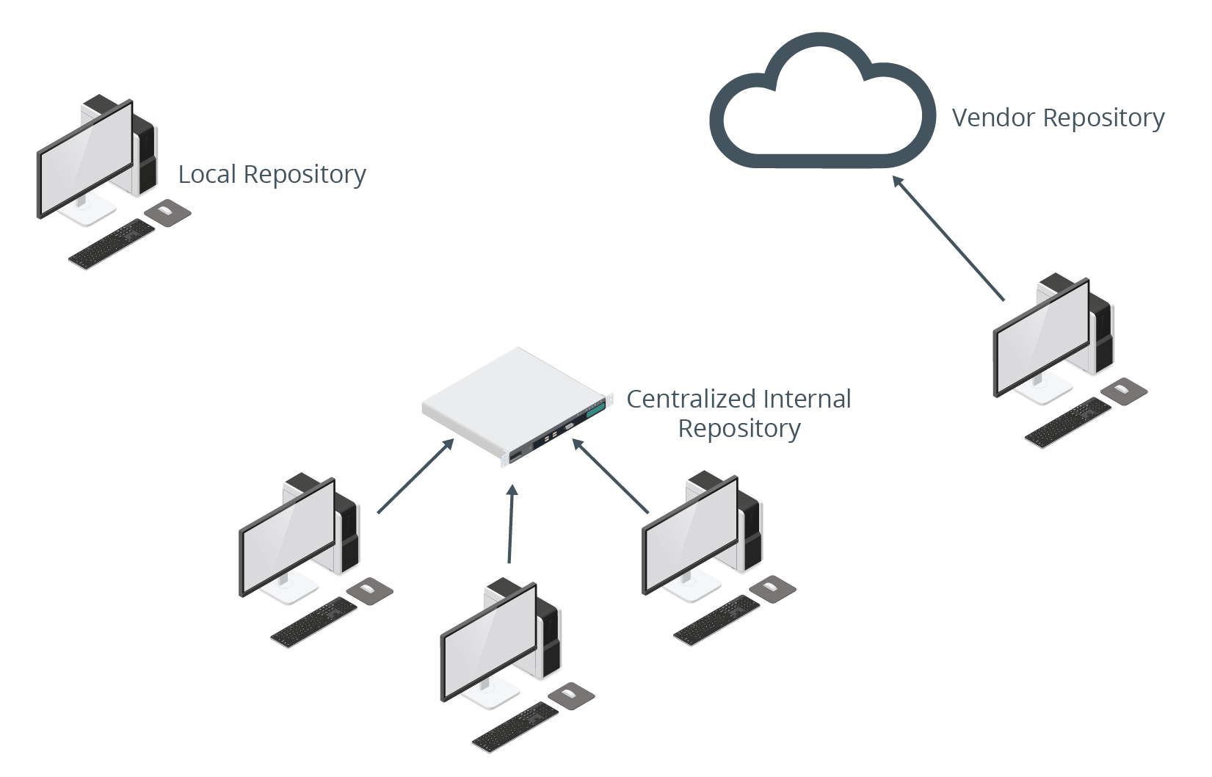
Repositories (Slide 2 of 2)

Slide 49
YUM Repository Configuration
Designate a location as a repo using createrepo
Updates XML files used to reference location.
Can be local drive, centralized server, or Internet-based.
Create .repo config file in /etc/yum.repos.d/
[repo-name]
name=Repository Name
baseurl=
enabled=1
gpgcheck=0
Notes:
Teaching Tip: If students are curious, GPG checks are used to verify the authenticity of a repository.

Slide 50
Repository Synchronization
YUM can sync online repo to local repo.
Also known as mirroring.
Reduces WAN traffic and lessens load on parent repo.
reposync is used to manage process.
You can sync parent repo once, or periodically.
Example: Sync RHN repo to local server.
RH servers can use local repo instead of going out to Internet.
Local repo might be updated nightly.

Slide 51
APT Repository Configuration
Repos are configured in:
/etc/apt/sources.list
/etc/apt/sources.list.d/
Can be local, centralized, or hosted on the Internet.
Format of entries:
deb URL distro-name components
Run apt update so APT knows about new repos.

Slide 52
Discussing Configuring Repositories

Slide 53
Activity 11-7: Discussing Configuring Repositories
What is the purpose of creating a centralized internal repository?
ANSWER:
This centralized approach makes version control much simpler.

Slide 54
Activity 11-7: Discussing Configuring Repositories
You have recently taken over support for a group of CentOS Linux servers formerly managed by a different system administrator. You have logged onto each one to check configurations and to update each system. When you attempted to update the systems, no updates were available. Which command can you run to find out which software repositories are configured?
ANSWER:
yum repolist

Slide 55
Activity 11-7: Discussing Configuring Repositories
You have created an internal repository for all your CentOS Linux servers but you are worried that it will be out of date in a few weeks. Downloading a new set of packages every few weeks is a daunting task. Is there any way to automate this process? If so, how?
ANSWER:
Yes, the reposync utility updates the repository automatically.

Slide 56
Activity 11-7: Discussing Configuring Repositories
You have a few Debian-based Linux systems mixed in with your CentOS ones and you need to configure repositories for those. After adding a new repository to the /etc/apt/sources.list file, which command can you run to let APT know about the new repositories?
ANSWER:
Run the apt update command.

Slide 57
Activity 11-7: Discussing Configuring Repositories
In a YUM repository configuration, what does the gpgcheck=0 entry do?
ANSWER:
It disables GPG checking for the repository.

Slide 58
Activity: Configuring Repositories
Version control is a concern at Develetech.
Develetech wants to manage an internal repo for packages.
You'll configure a local YUM repo.
You'll make the repo available on the network using Apache.
Notes:
Teaching Tip: Students disable SELinux here for classroom convenience. In a production environment, it's best practice to configure SELinux rather than disable it entirely.

Slide 59
Download Sites
Easy to download software from app vendors.
Also many sites that centralize software from different vendors.
Example software downloadable from the Internet:
Audacity
Atom
GIMP
Nmap
Can also search open source sites like GitHub for software.

Slide 60
Topic E: Acquire Software
Exam Objectives:
2.1 Given a scenario, conduct software installations, configurations, updates, and removals.

Slide 61
The wget and curl Commands
You can access websites from the CLI.
Useful when you know the URL.
wget and curl can be written into scripts.
Automates the downloading process.
wget example:
wget http://download.samba.org/pub/samba/samba-latest.tar.gz
curl example:
curl -o nmap-7.70.tar.bz2 https://nmap.org/dist/nmap-7.70.tar.bz2

Slide 62
.tar Files
tar is an archiver.
Bundles multiple files together (tarball).
Creates file with .tar extension.
Makes downloading files easier.
Admin can create a bundle of files for others to extract.
Example tarball creation:
tar -cvf tarball.tar file1 file2 file3

Slide 63
tar Command Options
Option | Used To
-c | Create tarball.
-x | Extract tarball.
-v | Enable verbose mode.
-r | Append files to tarball.
-t | Test tarball or list files in tarball.
-f | Specify name of tarball in next argument.

Slide 64
Compressed Files
File compression reduces file size.
More efficient for downloading.
Several compression utilities available.
gzip, bzip2, etc.
Compressed tarball takes on file extensions like:
.tar.gz
.tar.bz2
gzip command examples:
gzip {file name}
gzip -d {file name}
Notes:
Teaching Tip: File compression and archiving is discussed in more depth in a later lesson.

Slide 65
Discussing Acquiring Software

Slide 66
Activity 11-9: Discussing Acquiring Software
You need to transfer an entire directory, /2018, containing hundreds of files to five other servers. How can you bundle the files into a single file for transfer?
ANSWER:
tar -cvf 2018.financials.tar /2018

Slide 67
Activity 11-9: Discussing Acquiring Software
You have a tarball of a program that is 300 MB in size and that is too large for most email programs to handle. You need to somehow make the group of files smaller, but you also don't want to create multiple files to send. What is the solution?
ANSWER:
Use a compression program such as gzip to compress the files so that the collection of files is smaller and more manageable.

Slide 68
Activity 11-9: Discussing Acquiring Software
If you downloaded the file wordsmith-12.3.tar.gz, how would you retrieve its contents?
ANSWER:
First, uncompress the file: gzip -d wordsmith-12.3.tar.gz and then use the tar command to extract the files: tar -xvf wordsmith-12.3.tar

Slide 69
Activity 11-9: Discussing Acquiring Software
How do you use the wget command to download software?
ANSWER:
You need to know the complete path to the file you want to download. For example: wget http://www.site.example/downloads/documents.1.tar.gz

Slide 70
Activity 11-9: Discussing Acquiring Software
True or false? You can use the wget command to upload files to a web directory.
ANSWER:
False. The wget command is only for downloading files.

Slide 71
Activity: Acquiring Software
You are investigating ways to download software from the web.
You're considering a script to automate the process.
You'll use wget and curl to try downloads manually.
Notes:
Teaching Tip: Time permitting, consider demonstrating a software download site like SourceForge and how to acquire software from such a site.

Slide 72
Topic F: Build Software from Source Code
Exam Objectives:
2.1 Given a scenario, conduct software installations, configurations, updates, and removals.

Slide 73
Why Compile?
Vendor-packaged software is configured with generic settings.
You might want to modify those settings or the software itself.
Example: Optimize for use on specific hardware.
Compiling software is common in Linux.
For Windows and macOS, most software is pre-compiled.

Slide 74
Compilers
Compiling software requires a compiler.
Translates source code into machine-readable binaries.
GCC is a common Linux compiler.
Libraries might be required.
Vary by software.
Developers usually list required libraries.
Header files (.h) or library files (.a).

Slide 75
Libraries
Chunks of compiled code that can be used in programs to accomplish specific common tasks.
Shared libraries:
Enable modular program builds.
Reduce compilation time.
Compiled software must access necessary libraries while running.
Typically installed with distro.
General libraries are in /usr/lib/
Libraries for essential binaries are in /lib/
Sometimes included with program if not packaged with distro.

Slide 76
The ldd Command (Slide 1 of 2)
Enables users to view shared library dependencies for an app.
Useful for troubleshooting.
Useful for gathering system requirement info for an app.

Slide 77
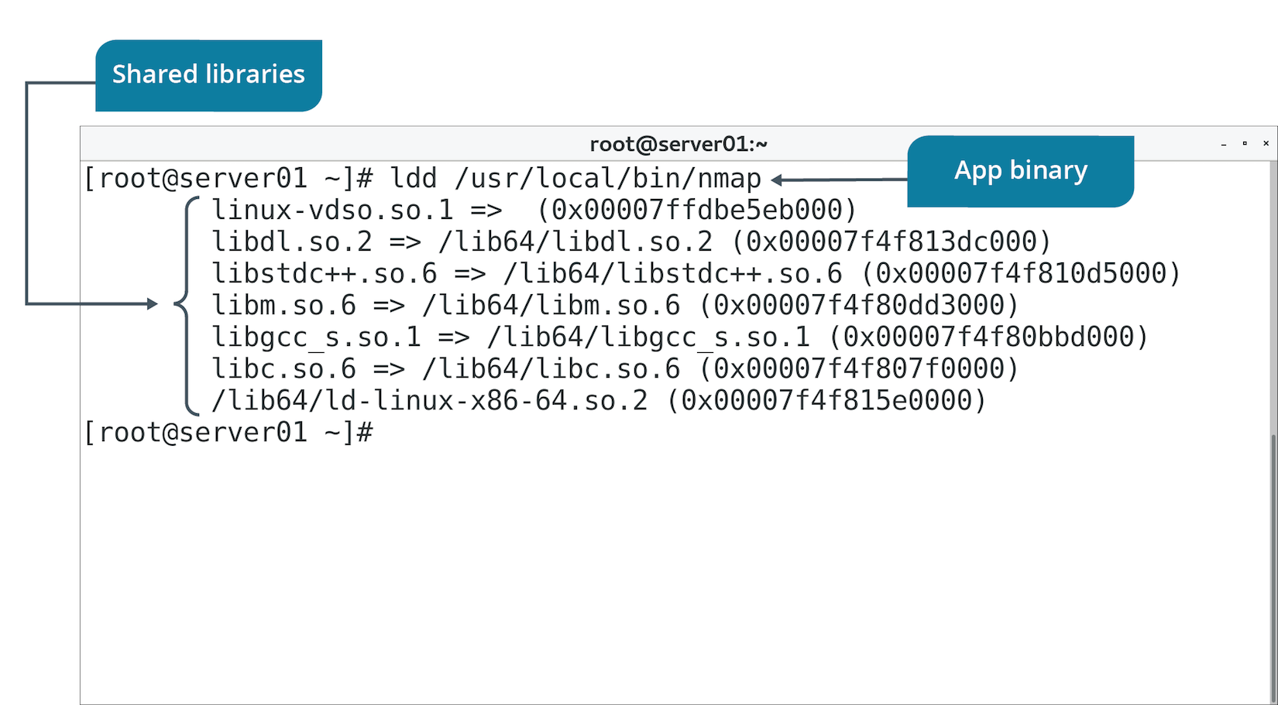
The ldd Command (Slide 2 of 2)

Slide 78
The Software Compilation Process
Unpack the download.
Change into created directory.
Run ./configure to create a makefile.
Use make to compile app based on makefile info.
Use make install to install app binaries.
Instructions may vary depending on software.
Example: Modifying makefile before make is run to optimize software.
Review README for info.

Slide 79
Discussing Building Software from Source Code

Slide 80
Activity 11-11: Discussing Building Software from Source Code
What does the ./configure command do?
ANSWER:
It gathers system information needed by the application to be compiled and stores it in the makefile.

Slide 81
Activity 11-11: Discussing Building Software from Source Code
You have downloaded, decompressed, and extracted a software program tarball, and run the ./configure command. What is the next step in the installation process?
ANSWER:
The next step is to run the make command.

Slide 82
Activity 11-11: Discussing Building Software from Source Code
Which command actually compiles the source code into executable code?
ANSWER:
The make command compiles the source code using the information in the makefile.

Slide 83
Activity 11-11: Discussing Building Software from Source Code
What is the final step in compiling software?
ANSWER:
The make install command is the final step.

Slide 84
Activity 11-11: Discussing Building Software from Source Code
What does the make install command do in the software compilation process?
ANSWER:
The make install command copies the compiled binaries to the predetermined directories.

Slide 85
Activity: Compiling and Installing an Application
Develetech wants to rely on Nmap to troubleshoot networked systems.
Compiling Nmap from source enables greater flexibility.
You'll do a basic compile of Nmap.

Slide 86
Topic G: Troubleshoot Software Dependency Issues
Exam Objectives:
4.4 Given a scenario, analyze and troubleshoot application and hardware issues.

Slide 87
Dependency Troubleshooting
Discover what packages exist before deployment.
Ensure needed dependencies are in repos.
To troubleshoot repos:
Verify network access.
Check repo configs (e.g., in /etc/yum.repos.d/)
When compiling:
Verify compiler and compiler version.
Confirm you have supporting libraries.

Slide 88
How YUM and APT Manage Dependencies
Both rely on info inside package to discover dependencies.
Both search repo for additional packages that are needed.
Can be configured to automatically install dependencies.
Simplifies installation process.

Slide 89
Guidelines for Troubleshooting Software Dependency Issues (Slide 1 of 2)
Software Dependencies/Repos:
Use rpm -V {package name} to verify components are installed.
Use rpm -qR {package name} or yum deplist {package name} to discover dependencies on RH.
Use apt-cache depends {package name} to discover dependencies on Debian distros.
Use repos and ensure dependencies are in repos.
Ensure repos are current.
Ensure connectivity to repos.
Patching/Update Issues:
Read patch docs before applying.
Ensure network connectivity.
Test patches/updates before deploying.
Ensure dependencies/versions are satisfied for patches/updates.
Check installation logs if there are issues.
Have a contingency plan in case patches cause problems.

Slide 90
Guidelines for Troubleshooting Software Dependency Issues (Slide 2 of 2)
GCC/Library Issues:
Check docs for required GCC or other compiler versions.
Verify required versions of kernel and dependencies.
Use ldd to check for shared library dependencies.
Verify library file versions/availability.
Compile/test program in VM.
Assume root privileges when issuing make install command.

Slide 91
Discussing Software Dependency Issues

Slide 92
Activity 11-13: Discussing Software Dependency Issues
What is a software dependency?
ANSWER:
A software dependency is one or more software packages that must be installed before a desired package is installed.

Slide 93
Activity 11-13: Discussing Software Dependency Issues
You have a CentOS system and you need to install an application that you know has a lot of dependencies. What can you do to satisfy those dependencies and install the application?
ANSWER:
Use the yum install command to install the application and its dependencies automatically.

Slide 94
Activity 11-13: Discussing Software Dependency Issues
You have a CentOS system that runs an application for your company, but anyone who runs it receives errors, as if some critical parts of the application were missing. How can you verify the application's components?
ANSWER:
Use the rpm -V <application name> command to verify that all components of the application are installed.

Slide 95
Activity 11-13: Discussing Software Dependency Issues
Being security conscious, you always check out any software package being installed to your CentOS systems. Which command can you run to check supporting software packages prior to installing a new software application?
ANSWER:
The yum deplist command displays dependencies so that you can see what's going to be installed with an application before it's installed.

Slide 96
Activity 11-13: Discussing Software Dependency Issues
Why do you need to assume root privileges when running the make install command?
ANSWER:
Because the make install command writes to system directories that only root has permission to write to.

Slide 97
Activity: Troubleshooting Dependency Issues
Develetech wants to ensure package managers are used effectively.
You'll answer the following questions to clarify the proper use of tools.

Slide 98
What packages might you need to install in your organization? Which package management tools will you use most often?
As an administrator, why might you create your own repositories?

